Slide 1
ESHAN COLLEGE OF ENGINEERING
Computer System Security
PPT’s
Prepared By: H.K.Sharma, Associate Professor,
CS Department,Ehsan College Of Engineering

Slide 2
ESHAN COLLEGE OF ENGINEERING
What is Security?
Computer Security
Protecting Computers, information and services from unauthorized access, change or destruction.
Internet security
Internet security extends this concept to systems that are connected to the Internet.
Vulnerable areas:
Browsing the Internet
Electronic Commerce
Social Networking
Emailing

Slide 3
ESHAN COLLEGE OF ENGINEERING
Cyber Security
Cyber Security is a set of principles and practices designed to safeguard your computing assets and online information against threats.

Slide 4
ESHAN COLLEGE OF ENGINEERING
Common Cyber Attack Actions
Accessing your personal computers, mobile phones, gaming systems and other internet- and Bluetooth-connected devices.
Damaging your financial security, including identity theft.
Blocking your access or deleting your personal information and accounts.
Complicating your employment or business services.
Impacting public services such as transportation and the power grid.

Slide 5
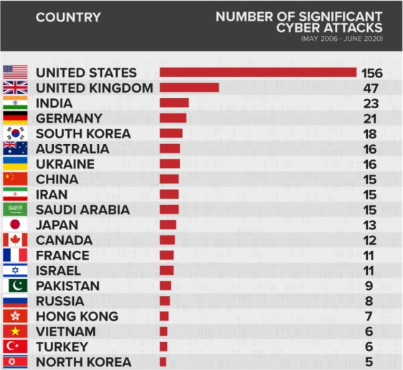
ESHAN COLLEGE OF ENGINEERING
Number of Significant Cyber Attacks
From May 2006 To June 2020

Slide 6
ESHAN COLLEGE OF ENGINEERING
Vulnerabilities identified
Newly identified and cumulative vulnerabilities per year
Figure source: X-Force Red

Slide 7
ESHAN COLLEGE OF ENGINEERING
Total cost of Cyber Crime
Cybercrime costs the global economy about 1 trillion — 50% more than that predicted in 2018. Also, it is more than 1% of the global GDP.
The average cost of a data breach in 2020 was a whopping $3.86 million. In 2021 it was $4.24 million.
A data breach compromising 1-10 million records costs $50 million on average, whereas one compromising 50 million records can cost as much as $392 million.

Slide 8
ESHAN COLLEGE OF ENGINEERING
Evolution of Cyber Attacks
The first cyber-attack on record was The Morris Worm in 1988. Robert Tappan Morris, a graduate student at Cornell University, developed a worm program that would crawl the web to count how many computers were connected to the internet. However, the worm installed itself on one in seven computers and forced them to crash. It was the first ditributed denial of service (DDoS) attack . The Morris Worm damaged around 6,000 computers, which then comprised 10% of the entire internet.
In 2002, the first internet attack occurred. It was a DDoS attack targeted the 13 DNS root servers.

Slide 9
ESHAN COLLEGE OF ENGINEERING
Recent cyber attacks
Zoom Conferencing Service Breach: In April 2020, a cyberattack known as Zoombombing enabled cyber criminals to join private meetings, access conversations, and share offensive images, videos, and screens.
Tether attack: In March 2021, cyber criminals threatened to leak documents from the Tether cryptocurrency. The attackers claimed the data would “harm the Bitcoin ecosystem” and demanded a settlement fee of around 500 Bitcoin ($24 million)
Facebook attack: Data of more than 530 million Facebook users, including their names, Facebook IDs, dates of birth, and relationship status, was published online in April 2021. Facebook, now Meta, said the information was obtained through scraping in 2019.

Slide 10
ESHAN COLLEGE OF ENGINEERING
Recent cyber attacks
Colonial Pipeline attack: In May 2021 the fuel pipeline operator suffered a ransomware attack launched by the DarkSide hacking group, which led to fuel disruption and mass panic buying across the U.S.
Omiai cyber attack: An unauthorized entry cyberattack in May 2021 resulted in the exposure of 1.7 million users of the Japanese dating app Omiai.

Slide 11
ESHAN COLLEGE OF ENGINEERING
Recent cyber attacks
Audi and Volkswagen Cybersecurity Breach: In June 2021, Audi and Volkswagen revealed a data breach had affected more than 3.3 million customers and prospective buyers, who were primarily U.S.-based. The breach was blamed on an associated vendor
WHO Attack: As the COVID-19 pandemic broke, an attack targeting the World Health Organization (WHO) resulted in the breach of 25,000 email addresses and passwords. The data was leaked online on April 19, 2020, along with information belonging to other groups fighting the pandemic, including the Gates Foundation, the National Institutes of Health (NIH), and the U.S. Centers for Disease Control and Prevention (CDC).
Russia-Ukraine conflict: FortiGuard Labs has determined that new viper malware was used to attack Ukrainian targets and discovered it installed on at least several hundred machines in Ukraine. Several Ukrainian organizations have also been targeted by sophisticated attacks that used the KillDisk and HermeticWiper malware strands, which appear to destroy data on devices.

Slide 12
ESHAN COLLEGE OF ENGINEERING
Security Attacks
Active Attack
An Active attack attempts to alter system resources or affect their operations. Active attacks involve some modification of the data stream or the creation of false statements. Types of active attacks are as follows:
Masquerade
Modification of messages
Replay
Denial of Service

Slide 13
ESHAN COLLEGE OF ENGINEERING
Active Attacks
Masquerade: one entity pretends to be a different entity.

Slide 14
ESHAN COLLEGE OF ENGINEERING
Active Attacks
Modification of Message: some portion of a message is altered or that message is delayed or reordered to produce an unauthorized effect.

Slide 15
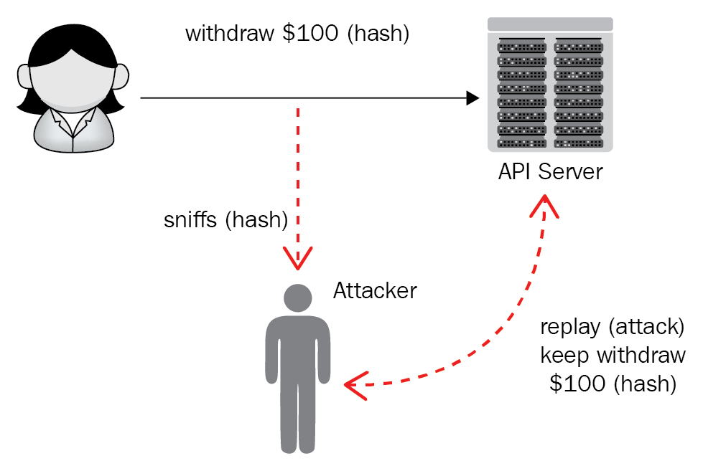
ESHAN COLLEGE OF ENGINEERING
Active Attacks
Replay: It involves the passive capture of a message and its subsequent transmission to produce an authorized effect.

Slide 16
ESHAN COLLEGE OF ENGINEERING
Active Attacks
Denial of Service : It prevents the normal use of communication facilities. Eg. Spam mails to overflow the mailbox.

Slide 17
ESHAN COLLEGE OF ENGINEERING
Security Attacks
Passive Attack:
It attempts to learn or make use of information from the system but does not affect system resources.

Slide 18
ESHAN COLLEGE OF ENGINEERING
Passive Attacks
The release of message content

Slide 19
ESHAN COLLEGE OF ENGINEERING
Passive Attacks
Traffic Analysis
The opponent could determine the location and identity of communicating host and could observe the frequency and length of messages being exchanged.
This information might be useful in guessing the nature of the communication that was taking place.

Slide 20
ESHAN COLLEGE OF ENGINEERING
Passive Attacks
Traffic Analysis
An intruder records network traffic using a packet analyzer tool, such as Wireshark, for later analysis.
Key loggers are used to record credentials

Slide 21
ESHAN COLLEGE OF ENGINEERING

Slide 22
ESHAN COLLEGE OF ENGINEERING

